Slide 1
Google's OAuth 2.0 APIs

Slide 2
Setting up OAuth 2.0
Before your application can use Google's OAuth 2.0 authentication system for user login, you must set up a project in the Google API Console to obtain OAuth 2.0 credentials, set a redirect URI, and (optionally) customize the branding information that your users see on the user-consent screen. You can also use the API Console to create a service account, enable billing, set up filtering, and do other tasks. For more details, see the Google API Console Help.

Slide 3
Obtain OAuth 2.0 credentials
You need OAuth 2.0 credentials, including a client ID and client secret, to authenticate users and gain access to Google's APIs.
To view the client ID and client secret for a given OAuth 2.0 credential, click the following text: Select credential. In the window that opens, choose your project and the credential you want, then click View.
Or, view your client ID and client secret from the Credentials page in API Console:
Go to the Credentials page.
Click the name of your credential or the pencil (create) icon. Your client ID and secret are at the top of the page.

Slide 4
Set a redirect URI
The redirect URI that you set in the API Console determines where Google sends responses to your authentication requests.
To create, view, or edit the redirect URIs for a given OAuth 2.0 credential, do the following:
Go to the Credentials page.
In the OAuth 2.0 client IDs section of the page, click a credential.
View or edit the redirect URIs.
If there is no OAuth 2.0 client IDs section on the Credentials page, then your project has no OAuth credentials. To create one, click Create credentials.

Slide 5
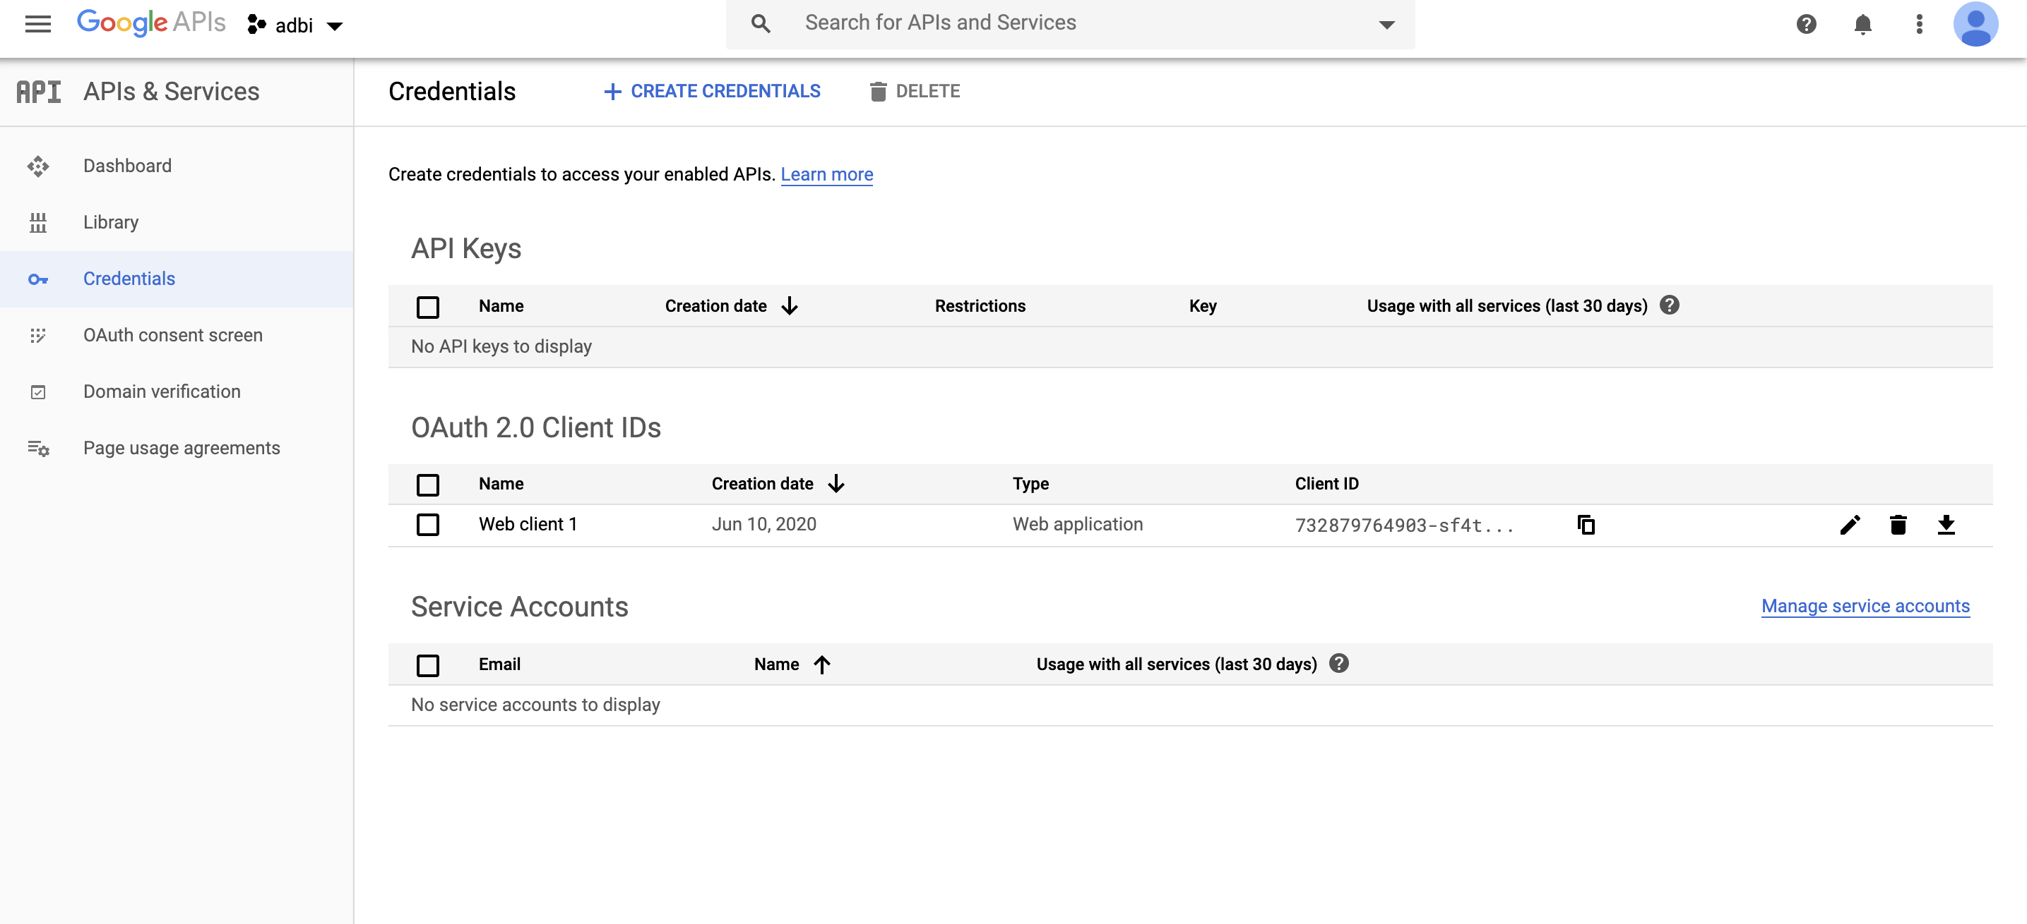
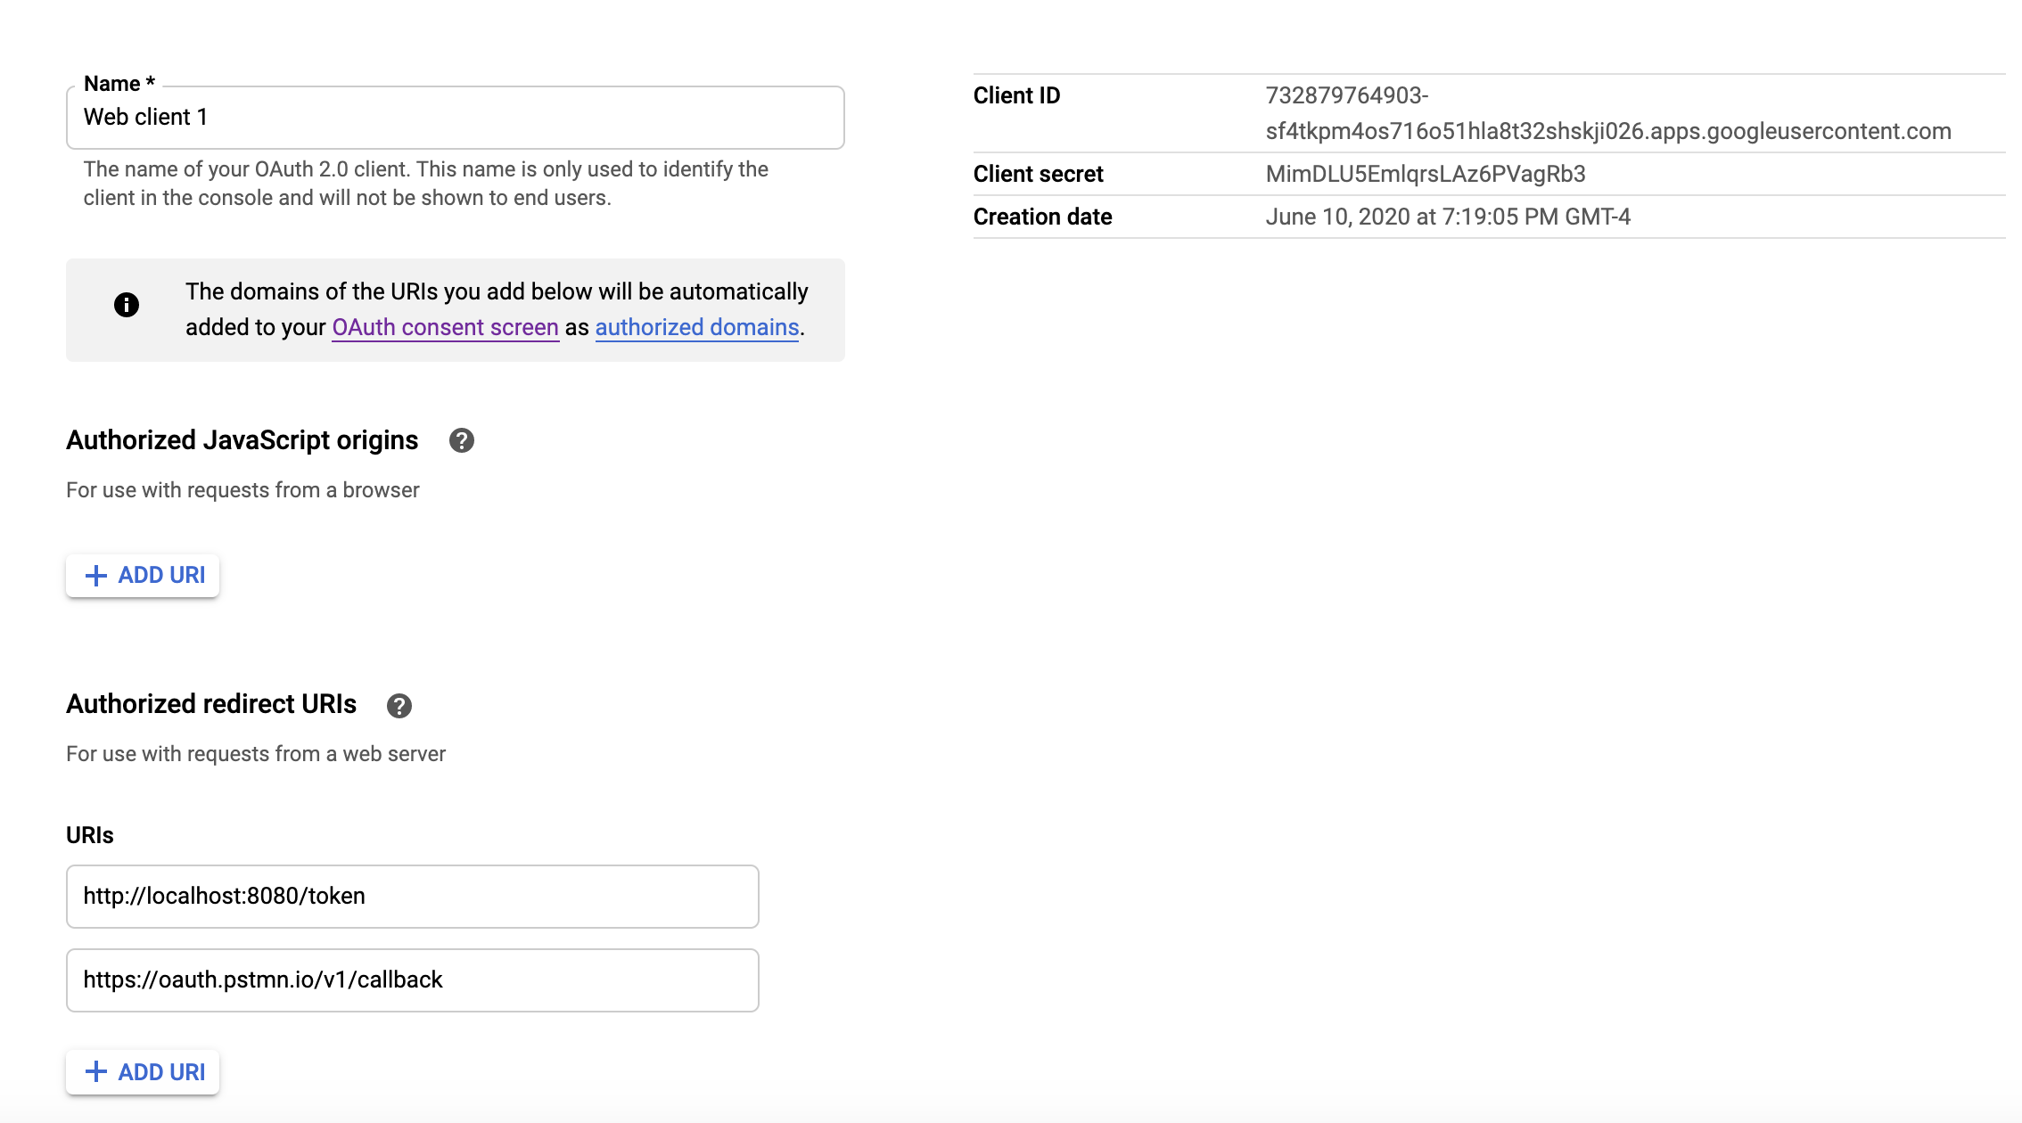
Credentials Page

Slide 6
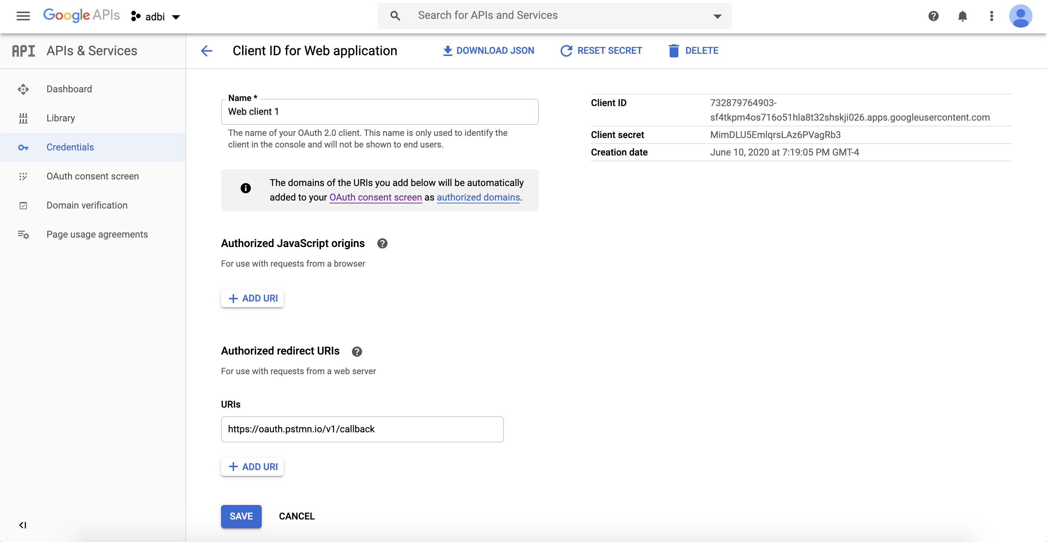
Credentials to authenticate users and gain access to Google's APIs
The redirect URI that you set in the API Console determines where Google sends responses to your authentication requests.

Slide 7
Customize the user consent screen
For your users, the OAuth 2.0 authentication experience includes a consent screen that describes the information that the user is releasing and the terms that apply. For example, when the user logs in, they might be asked to give your app access to their email address and basic account information. You request access to this information using the scope parameter, which your app includes in its authentication request. You can also use scopes to request access to other Google APIs.
The user consent screen also presents branding information such as your product name, logo, and a homepage URL. You control the branding information in the API Console.
To enable your project's consent screen:
Open the Consent Screen page in the Google API Console.
If prompted, select a project, or create a new one.
Fill out the form and click Save.
The following consent dialog shows what a user would see when a combination of OAuth 2.0 and Google Drive scopes are present in the request. (This generic dialog was generated using the Google OAuth 2.0 Playground, so it does not include branding information that would be set in the API Console.)

Slide 8
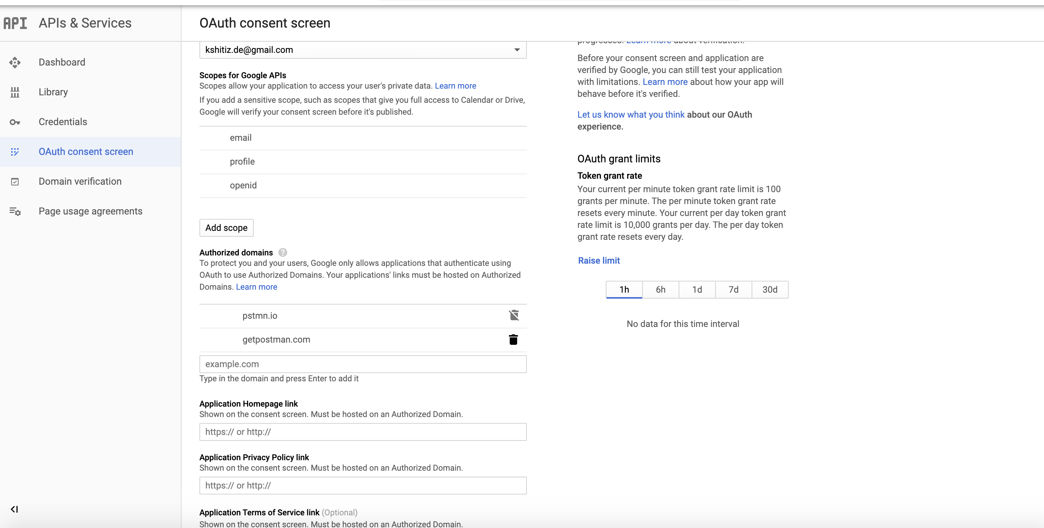
Set the authorized domains to postman.io or getpostman.com as shown in the fig

Slide 9
Send an authentication request to Google
The next step is forming an HTTPS GET request with the appropriate URI parameters. Note the use of HTTPS rather than HTTP in all the steps of this process; HTTP connections are refused. You should retrieve the base URI from the Discovery document using the authorization_endpoint metadata value. The following discussion assumes the base URI is https://accounts.google.com/o/oauth2/v2/auth.
For a basic request, specify the following parameters:
client_id, which you obtain from the API Console Credentials page .
response_type, which in a basic authorization code flow request should be code. (Read more at response_type.)
scope, which in a basic request should be openid email. (Read more at scope.)
redirect_uri should be the HTTP endpoint on your server that will receive the response from Google. The value must exactly match one of the authorized redirect URIs for the OAuth 2.0 client, which you configured in the API Console Credentials page. If this value doesn't match an authorized URI, the request will fail with a redirect_uri_mismatch error.
state should include the value of the anti-forgery unique session token, as well as any other information needed to recover the context when the user returns to your application, e.g., the starting URL. (Read more at state.)
nonce is a random value generated by your app that enables replay protection when present.
login_hint can be the user's email address or the sub string, which is equivalent to the user's Google ID. If you do not provide a login_hint and the user is currently logged in, the consent screen includes a request for approval to release the user's email address to your app. (Read more at login_hint.)
Use the hd parameter to optimize the OpenID Connect flow for users of a particular G Suite domain. (Read more at hd.)

Slide 10
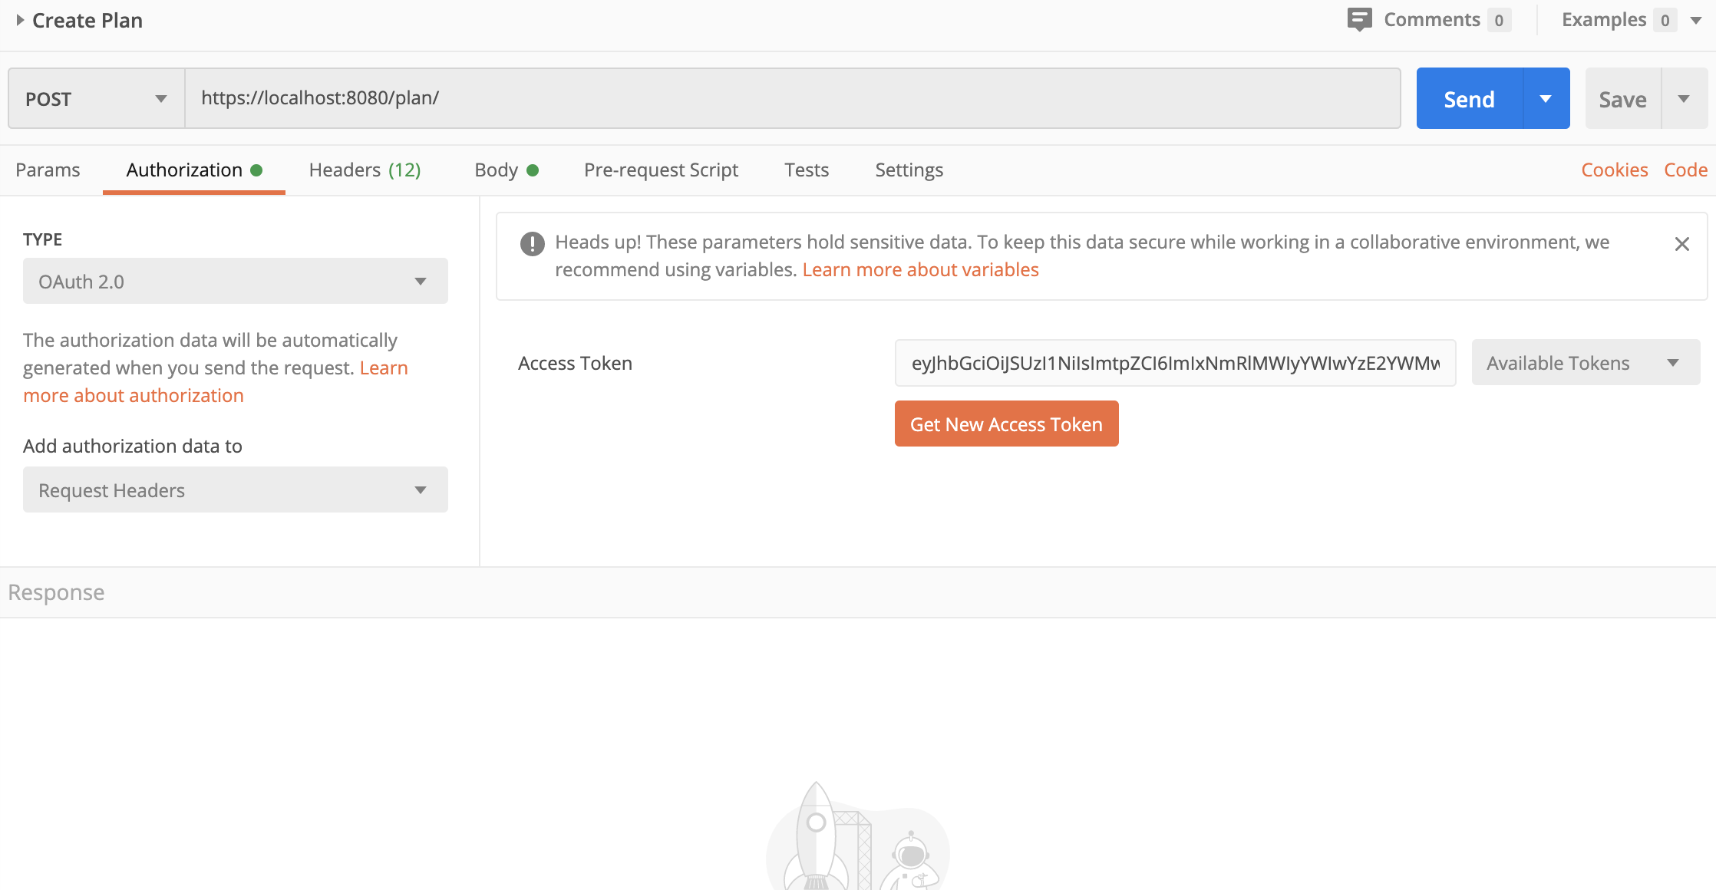
Postman Configuration :
Select the type as Oauth2.0
Set the Add authorization data to Request Headers as shown in the fig.
Then click on Get New Access Token Button to create and send the authentication request to google

Slide 11
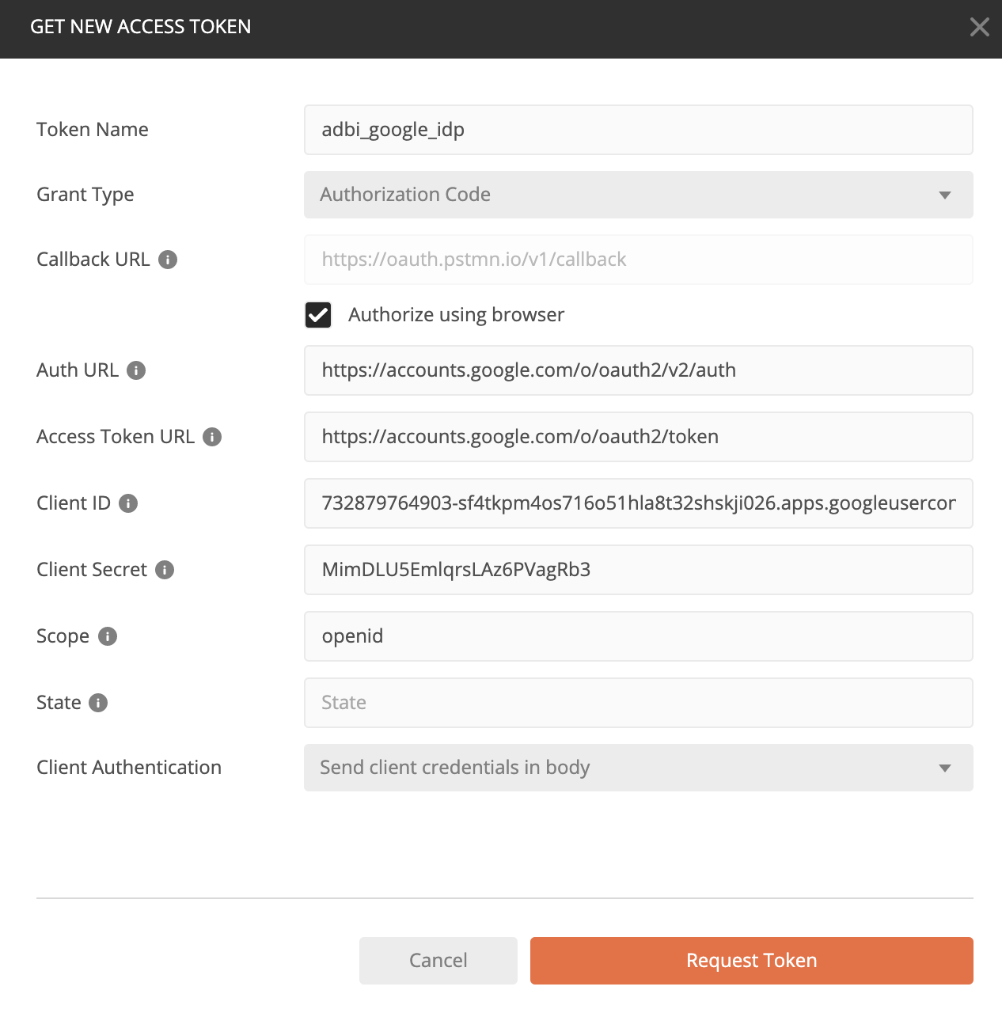
Authentication Request to Google:

Slide 12
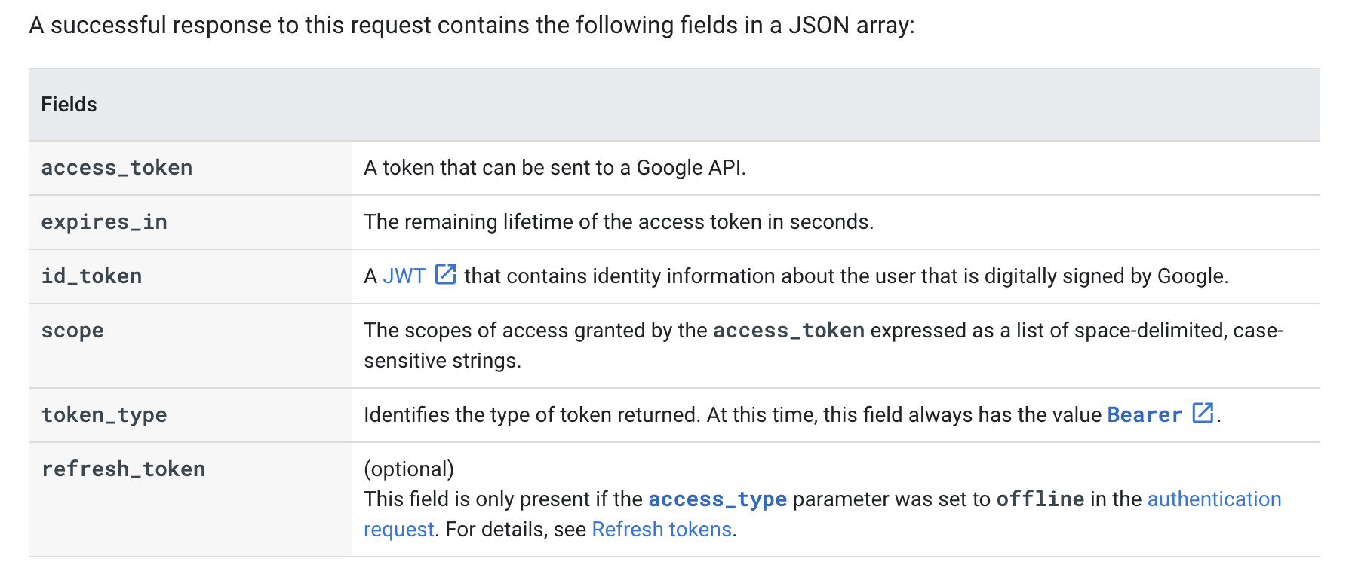

Slide 13
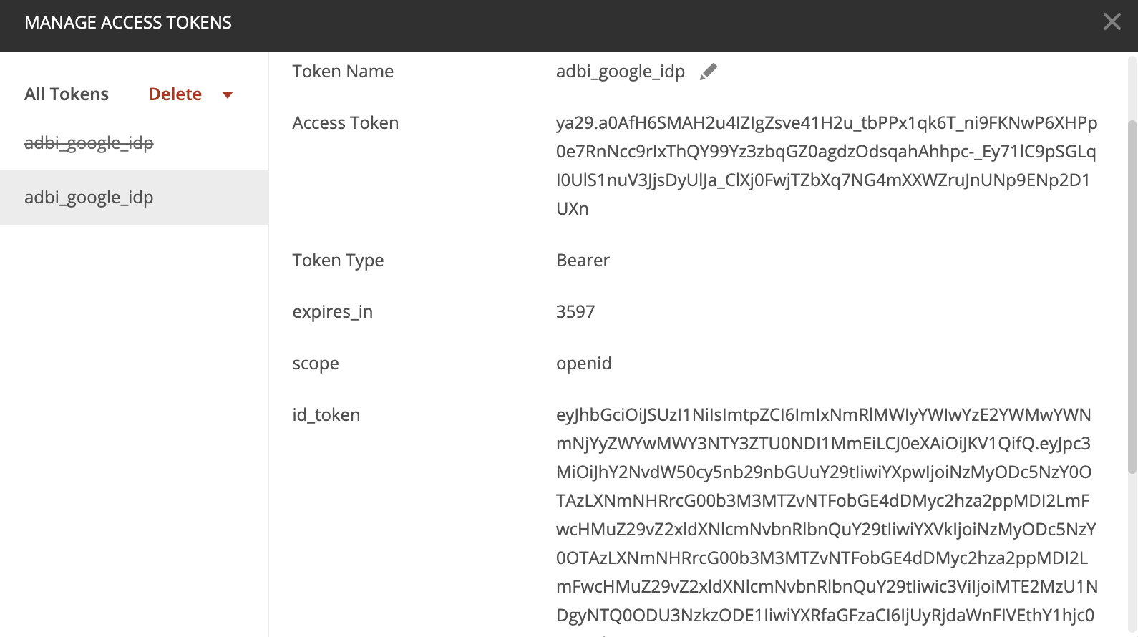
This is how Google’s response in postman looks like:

Slide 14
Reference Links:
Goolge’ step by step guide to setup Oauth 2.0:
https://developers.google.com/api-client-library/java/google-api-java-client/setup
Authenticating token with a backend server:
https://developers.google.com/identity/sign-in/web/backend-auth

